Slide 1
STUDENT INTERNSHIP PROJECT · AI & CYBERSECURITY
AI Linux Security Assistant
An intelligent tutor that explains Linux commands, analyzes file permissions,
and recommends secure hardening practices — without ever executing user input.
Basaaria Imroz
B.E. CSE (AI & ML)
AI & Cybersecurity Internship
MRIIRS In collaboration with Ditto Security
Notes:
Good [morning/afternoon] everyone. My name is Basaaria Imroz, and today I'll be presenting my project, the AI Linux Security Assistant, built during my AI and Cybersecurity internship with the School of Computer Applications in collaboration with Ditto Security. In one line: it's an intelligent tutor that explains Linux commands, analyzes file permissions, and recommends hardening steps -- and it never actually executes anything the user types, so it's completely safe to experiment with. Let's get into it.

Slide 2
AGENDA
What We'll Cover
01
Problem Statement
02
Existing vs. Proposed
Why beginners struggle with Linux command & permission risk
Manual guesswork vs. a structured AI-assisted workflow
03
System Architecture
04
Live Feature Walkthrough
How the modules connect using a ReAct-style pipeline
Command explainer, permission analyzer, hardening & reports
05
Testing & Results
06
Scope, Limitations & Future Work
Verified test cases across command and permission scenarios
What's next for the assistant
AI Linux Security Assistant
2
Notes:
Here's a quick roadmap for the next few minutes. I'll start with the problem this project solves, then compare the existing manual approach with what I built. After that I'll walk through the system architecture, give a live look at the four core features with actual screenshots, share my testing results, and close with scope, limitations, and what I'd add next.

Slide 3
THE PROBLEM
One Risky Command Is All It Takes
Students learning Linux often copy commands from search results or tutorials and run them without understanding the consequences. A command that looks like it “fixes” an access error can silently expose files, delete data, or grant every local user full control.
A COMMON MISTAKE
$ chmod 777 script.sh
What it actually does: grants read, write, and execute access to the owner, the group, AND every other user on the system.
!
No unified explanation of purpose, syntax & risk
!
Permission strings (rwxrwxrwx) are manually decoded
RISK LEVEL
!
No immediate Low / Medium / High / Critical rating
CRITICAL
!
Hardening guidance is scattered across many guides
Safer alternative: chmod 750 (script/directory) or chmod 640 (private file)
AI Linux Security Assistant
3
Notes:
So why does this project matter? Linux is extremely powerful, but that power cuts both ways for a beginner. Students often hit a permission error, search online, copy the first command that promises to 'fix' it, and run it without understanding the side effects. The classic example is right here: chmod 777. It looks like a quick fix, but it actually gives read, write, and execute access to literally everyone on the system -- the owner, the group, AND every other user. That's a critical security risk, and a safer choice would be something like chmod 750 or 640 depending on the file. My project exists to catch exactly this kind of mistake before it happens, not after.

Slide 4
SYSTEM STUDY
Existing Workflow vs. Proposed Assistant
Existing Approach
AI Linux Security Assistant
Search engines, tutorials & trial-and-error
One dashboard: command, output & permission input
Manual decoding of permission triplets
Automatic owner / group / other breakdown
Risk awareness depends on learner experience
Deterministic Low–Critical risk classification
Copy-pasted commands run without review
Commands are parsed only — never executed
Manual notes / screenshots for documentation
One-click downloadable PDF security report
AI Linux Security Assistant
4
Notes:
Let's compare the old way of doing this with what I built. Today, students rely on search engines, scattered tutorials, and trial and error. Permission strings like rwxrwxrwx have to be decoded by hand, risk awareness depends entirely on how experienced the learner is, and commands often get copy-pasted and run without any real review. Documentation, if it happens at all, is just manual notes or screenshots. My assistant replaces that with one dashboard where you drop in a command, terminal output, or permission string, and instantly get an automatic owner-group-other breakdown, a consistent Low-to-Critical risk rating, and -- most importantly -- the command is only ever parsed as text, never executed. And at the end, you get a one-click PDF report for documentation.

Slide 5
AIMS & OBJECTIVES
What the Project Set Out to Do
1
2
3
Explain
Analyze
Classify
Translate raw Linux commands into beginner-friendly purpose, syntax & usage.
Break down symbolic & octal permissions into owner / group / other access.
Rate every finding Low, Medium, High, or Critical using consistent rules.
4
5
6
Recommend
Harden
Report
Suggest least-privilege alternatives and safe security commands.
Provide a reusable checklist covering SSH, firewall, accounts & updates.
Generate a downloadable PDF record of every assessment for review.
AI Linux Security Assistant
5
Notes:
These six objectives guided every design decision. First, explain -- turn a raw command into plain-English purpose and usage. Second, analyze -- break permissions down into owner, group, and other. Third, classify -- give every finding a consistent risk rating so nothing is left ambiguous. Fourth, recommend -- don't just flag the problem, suggest the least-privilege fix. Fifth, harden -- provide a reusable checklist for SSH, firewall, accounts, and updates. And sixth, report -- generate a downloadable record of the whole assessment. Together these objectives turn the tool from a simple checker into a genuine tutor.

Slide 6
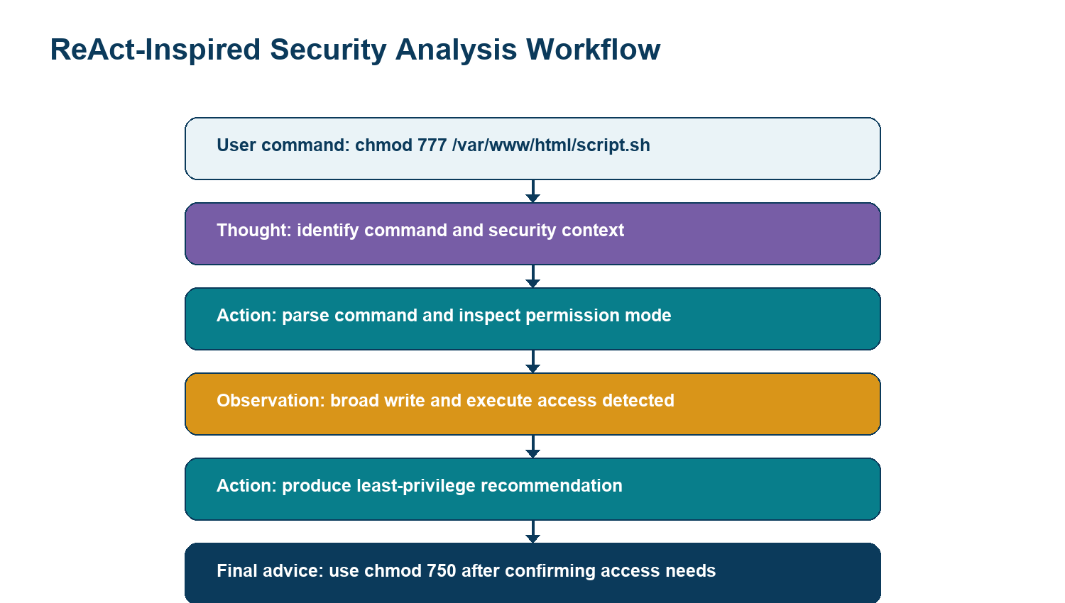
SYSTEM DESIGN
Modular Architecture & ReAct Workflow
REACT REASONING LOOP
1
Thought Identify whether input is a command, output, or permission string.
2
Action Call the matching tool: Command Parser or Permission Analyzer.
3
Observation Collect structured findings and an initial risk rating.
4
Action Run Hardening & Security Command Suggestion tools.
5
Result Agent aggregates a security score and renders the report.
AI Linux Security Assistant
6
Notes:
Under the hood, the system follows a ReAct-inspired reasoning loop -- Thought, Action, Observation, repeated until a final recommendation is ready. Walking through the example on screen: the user enters chmod 777 on a script. The agent's first Thought is to identify the command and its security context. Its Action is to parse the command and inspect the permission mode. The Observation comes back: broad write and execute access detected. It then takes another Action to produce a least-privilege recommendation, and finally delivers the advice -- use chmod 750 after confirming the actual access need. On the right, you can see this same loop generalized: Thought, Action, Observation, then a second Action for hardening suggestions, ending in a security score and full report.

Slide 7
TECHNOLOGY STACK
Built with a Lightweight, Free & Open-Source Stack
Python 3.11+
Streamlit
ReportLab
Core language for parsing, rules & orchestration
Interactive local/web dashboard, zero front-end code
Generates the downloadable PDF security report
Pandas / Plotly
Rule-based Engine
Optional LLM Hook
Structured display & the security-score gauge
Offline command & permission knowledge base
OpenAI / Gemini / Ollama for richer summaries
Runs fully offline — no API key or paid service required for the baseline rule-based experience.
AI Linux Security Assistant
7
Notes:
On the technology side, I deliberately kept the stack lightweight and entirely free and open-source. Python 3.11 handles all the parsing and rule logic, Streamlit gives me an interactive dashboard without writing any separate front-end code, and ReportLab generates the downloadable PDF. Pandas and Plotly power the structured displays and the security-score gauge. The core intelligence is a rule-based knowledge engine I built covering common commands and permission patterns, so the baseline tool works completely offline with zero API cost. I also added an optional hook for OpenAI, Gemini, or Ollama, so richer natural-language summaries can be layered on top later without changing the core architecture.

Slide 8
CORE CAPABILITIES
Four Tools Working Together
01
Command Explanation Tool
Purpose, syntax, options, typical usage & security considerations for common commands (chmod, sudo, ssh, ufw, iptables & more).
02
Permission Analyzer
Detects world-writable/executable files, weak modes, SUID/SGID bits and converts symbolic ↔ octal notation.
03
Hardening Recommendation Tool
A curated checklist: SSH config, firewall policy, account hygiene, Fail2Ban, patching & audit logging.
04
Security Report Generator
Combines every finding into a structured, downloadable PDF with a final security score out of 100.
AI Linux Security Assistant
8
Notes:
The whole system is really four tools working together. The Command Explanation Tool covers commands like chmod, sudo, ssh, ufw, and iptables, giving purpose, syntax, options, and security considerations for each. The Permission Analyzer detects world-writable and world-executable files, weak modes, and SUID or SGID bits, and converts freely between symbolic and octal notation. The Hardening Recommendation Tool is a curated checklist covering SSH configuration, firewall policy, account hygiene, Fail2Ban, patching, and audit logging. And finally, the Security Report Generator pulls everything together into one downloadable PDF with a final security score out of 100. Let me show you these live.

Slide 9
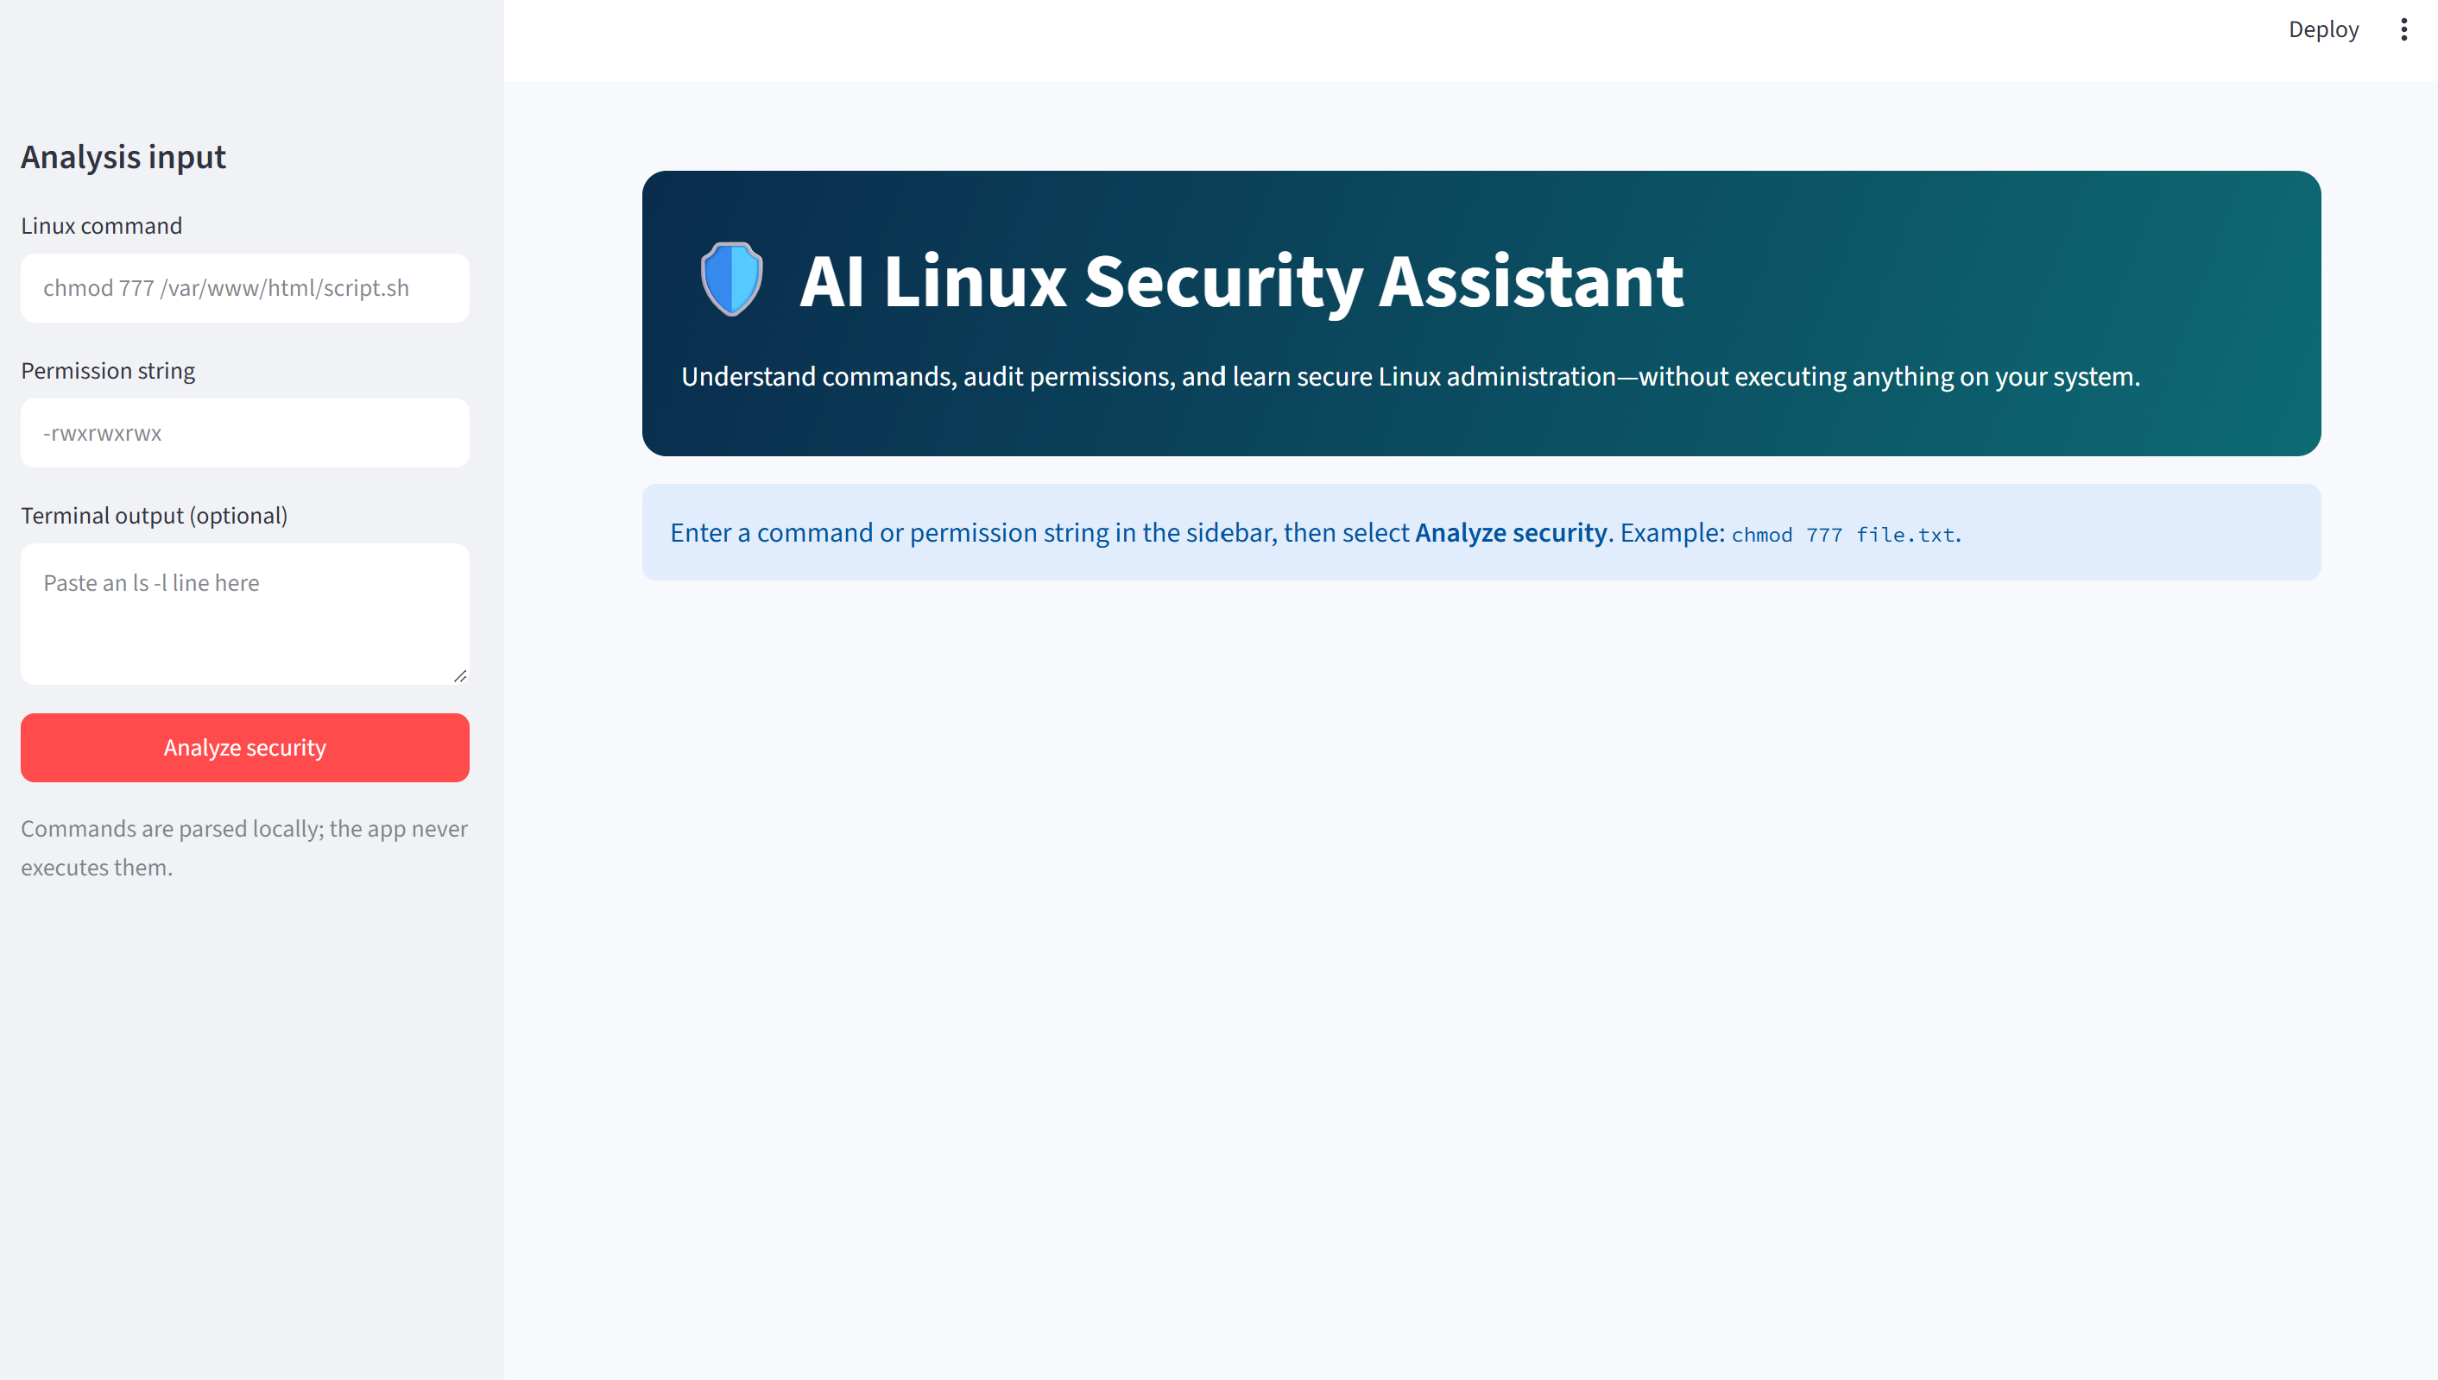
LIVE WALKTHROUGH · STEP 1
Enter a Command or Permission String
The sidebar keeps input minimal: a Linux command field and a permission-string field. No file uploads, no server setup.
AI Linux Security Assistant
9
Notes:
This is the actual running application. On the left is the sidebar where a user pastes a Linux command -- here, chmod 777 /var/www/html/script.sh -- and, optionally, a permission string like dash-r-w-x-r-w-x-r-w-x. That's it. One button, Analyze Security, and the assessment begins. Notice the safety principle stated right on screen: user commands are parsed locally and are never executed. That guarantee was a core design decision from day one.

Slide 10
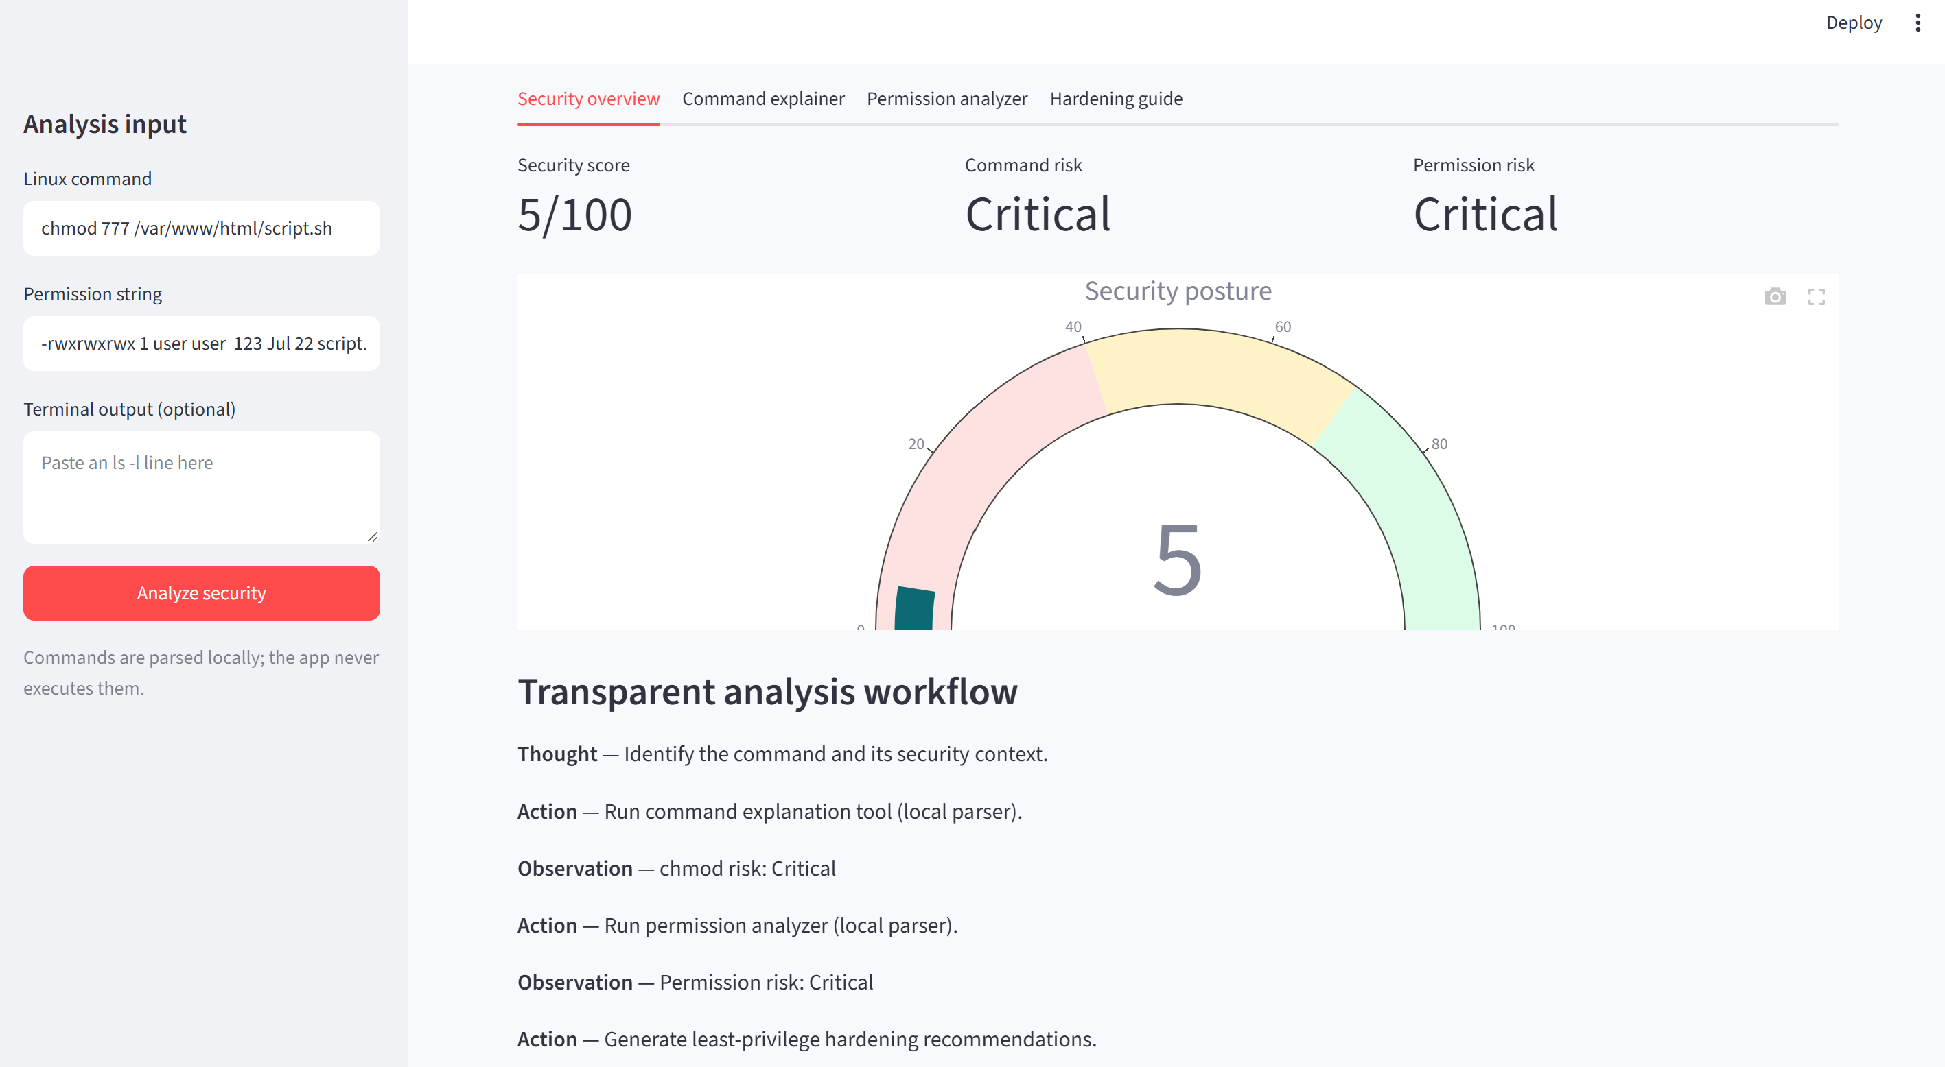
LIVE WALKTHROUGH · STEP 2
Instant Risk Score & Security Findings
For chmod 777 /var/www/html/script.sh with -rwxrwxrwx: a 5/100 score, Critical command & permission risk, plain-language findings, and the transparent Thought → Action → Observation trace.
AI Linux Security Assistant
10
Notes:
As soon as I click Analyze, this is what comes back. Three cards up top: a security score of 5 out of 100, Critical command risk, and Critical permission risk -- because chmod 777 combined with an already world-writable, world-executable file is about as bad as it gets. Below that, the security findings are written in plain language: 'world-writable, any local user can modify this item', 'world-executable, every user can execute or traverse this item', and then the fix -- chmod 750 for that directory or script. And at the bottom, you can literally see the agent's transparent reasoning trail -- Thought, Action, Observation, Action -- so the user isn't just told an answer, they can see how the assistant got there.

Slide 11
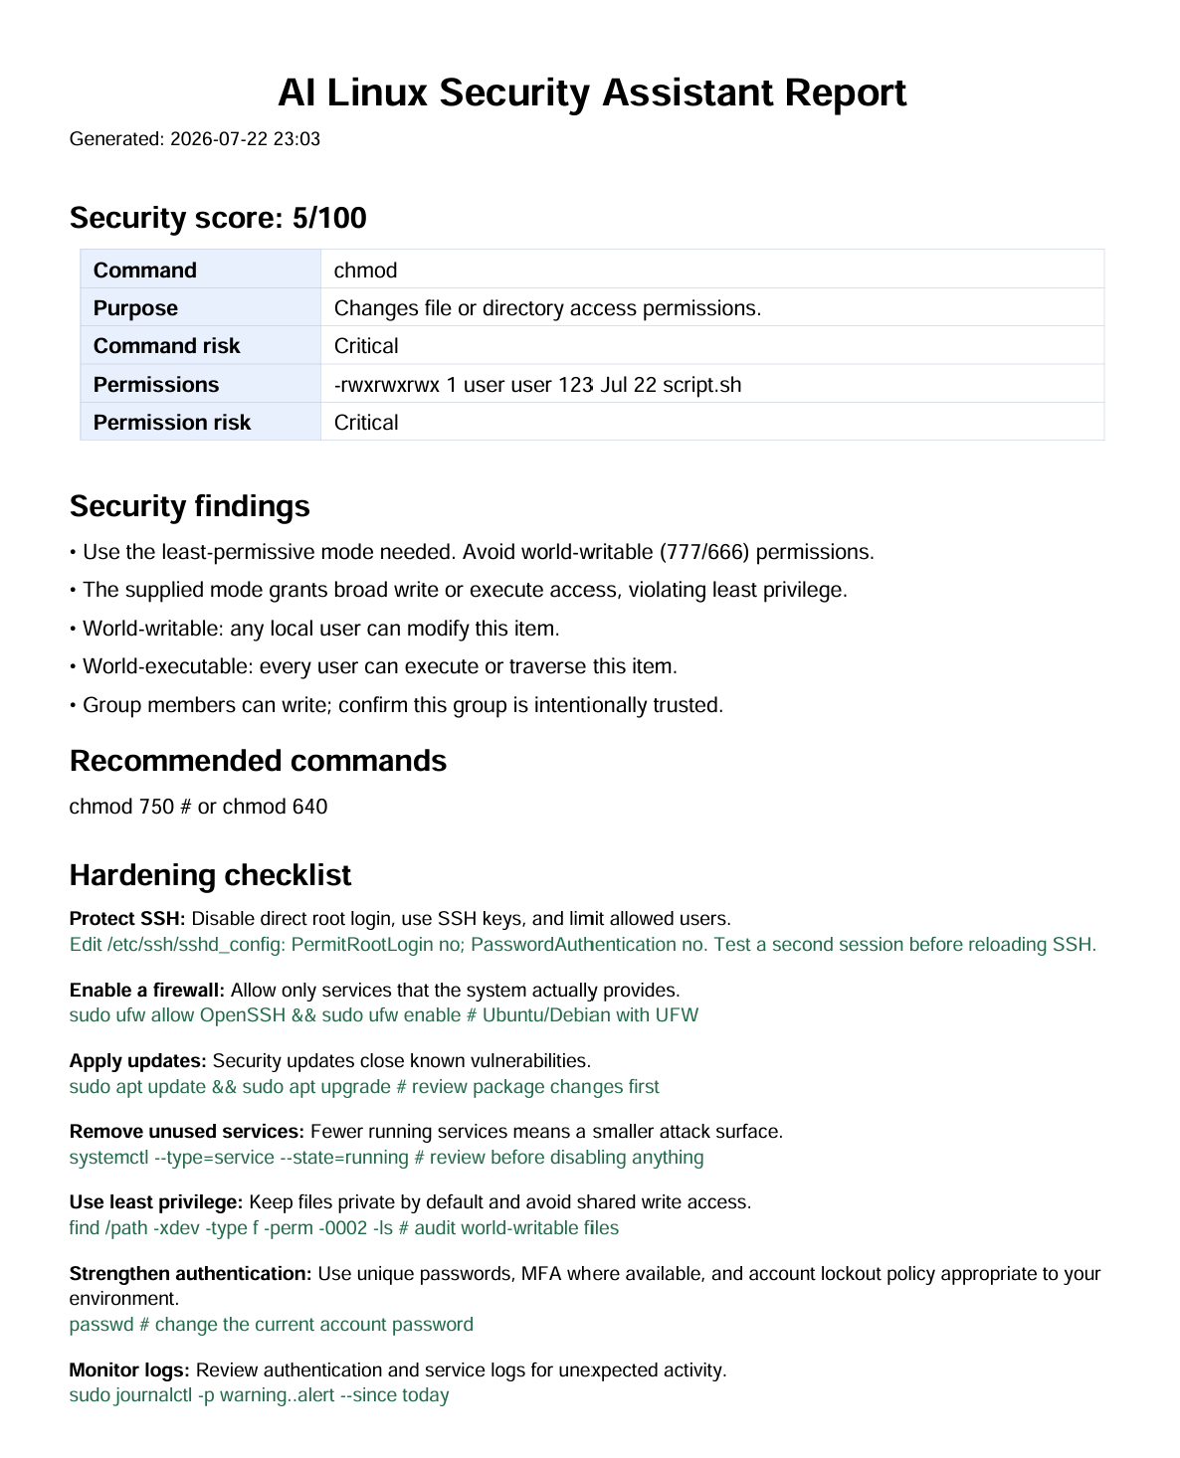
LIVE WALKTHROUGH · STEP 3
One-Click Downloadable PDF Report
✓
Security score, command, and permission summary at a glance
✓
Findings written in plain, beginner-friendly language
✓
Recommended commands for the safer alternative
✓
Full hardening checklist with example commands
✓
Ready to submit as classroom / academic evidence
AI Linux Security Assistant
11
Notes:
Finally, every assessment can be exported as a PDF with one click, using ReportLab. On the left you can see an actual generated report for that same chmod 777 example -- the security score, a command and permission summary table, the findings, recommended commands, and the full hardening checklist, all in one document. This was important for the academic context of this project: a student can attach this PDF directly to an assignment or lab submission as evidence of the analysis they performed.

Slide 12
SYSTEM TESTING
Verified Across Representative Test Scenarios
ID | Scenario | Expected Result | Status
TC01 | chmod 777 file.txt | Critical risk + safer 750/640 suggestion | Pass
TC02 | Permission string -rwxrwxrwx | World-writable & world-executable findings | Pass
TC03 | chmod 640 file.txt | Low risk, numeric mode 640 confirmed | Pass
TC04 | rm -rf /var/tmp/testdir | High/Critical warning on recursive delete | Pass
TC05 | curl http://x | sh | Critical warning on piping remote code | Pass
TC06 | ssh user@server | Purpose explained + key-based auth advice | Pass
TC07 | Malformed permission input | Friendly format guidance, no crash | Pass
7 / 7
TEST CASES PASSED
Covering chmod risk, world-writable permissions, safe low-risk modes, recursive deletion, remote-script execution, SSH usage & malformed input handling.
AI Linux Security Assistant
12
Notes:
To validate the system, I designed seven test cases covering the scenarios that matter most for a beginner: a critical chmod command, a fully open permission string, a safe low-risk mode, a dangerous recursive delete, a risky remote script piped into a shell, a routine SSH connection, and deliberately malformed input to make sure the app fails gracefully instead of crashing. All seven passed. The key takeaway from testing wasn't just that the logic works -- it's that the application never once needed to execute a shell command to produce these results, which was the core safety requirement of the whole project.

Slide 13
LOOKING AHEAD
Scope, Limitations & Future Enhancements
In Scope Today
Current Limitations
Future Enhancements
chmod, chown, sudo, rm, ssh, ufw, systemctl & more
No live scan of a real Linux host
Optional consent-based LLM for richer answers
Symbolic & octal permission analysis
No ACL / SELinux policy parsing
Distribution-aware advice (Ubuntu/RHEL/Kali)
Hardening checklist + PDF report export
Score is educational, not an enterprise rating
Docker-based safe lab mode for demos
AI Linux Security Assistant
13
Notes:
I want to be transparent about where this stands today. In scope right now: a solid set of common commands, full symbolic and octal permission analysis, and the hardening checklist with PDF export. The honest limitations: it doesn't scan a live Linux host, it doesn't parse ACLs or SELinux policies, and the security score is educational rather than an enterprise-grade rating -- it reflects only what the user typed in. Looking ahead, I'd like to add an optional consent-based LLM layer for richer conversational answers, distribution-aware advice for Ubuntu, RHEL, and Kali, and a Docker-based safe lab mode so people can practice hardening a real sandboxed system without any risk.

Slide 14
CONCLUSION
Pause. Understand. Then Act.
The AI Linux Security Assistant bridges Linux command learning and cybersecurity awareness — encouraging every learner to understand a command, inspect its permissions, weigh the risk, and choose the least-privilege option before touching a real system.
Thank You
Basaaria Imroz · AI Linux Security Assistant
Notes:
To close: the biggest value of this project isn't automation, it's the pause it creates. Before a command runs, before a permission changes, the assistant gives the learner a moment to actually understand what they're about to do -- the purpose, the risk, and a safer alternative -- and it does that without ever touching the real system itself. That's the AI Linux Security Assistant. Thank you, and I'm happy to take any questions.

